Slide 1

Project 1 – radio modulation recognition
Juan tarrat

Slide 2
introduction
Task was to re-do simulation in paper “Convolutional Radio Modulation Recognition Networks
Machine Learning library used: keras
Developed 5 DNN models and 3 CNN models making variations on the original paper’s contributions and evaluated results.
All models use Adam optimizer (some change the learning rate parameter)

Slide 3
Radio ML dataset
Specialized collection of datasets for radio signal modulation classification
11 modulation classes (8 digital and 3 analog) with variable SNR
Downloaded as a python dictionary with the format:
Key: Tuple of (modulation, snr)
Value: 2x128 time series
Included function to plot the 11 modulations given a SNR
Notes:
SNR = signal to noise ratio
Show code

Slide 4
Architecture of dnn models
There were 6 Dense models built (model 1 is the one in the paper)
The models I developed have the following characteristics:
Input layer of 128 neurons
Hidden layer of 1024 neurons
Hidden layer of 512 neurons
Output layer of 11 neurons
Cross-entropy loss
Trained over 100 epochs
Models 2 through 5 vary in the activation function they use (sigmoid, tanh, selu, elu)
Model 6 uses a different learning rate

Slide 5
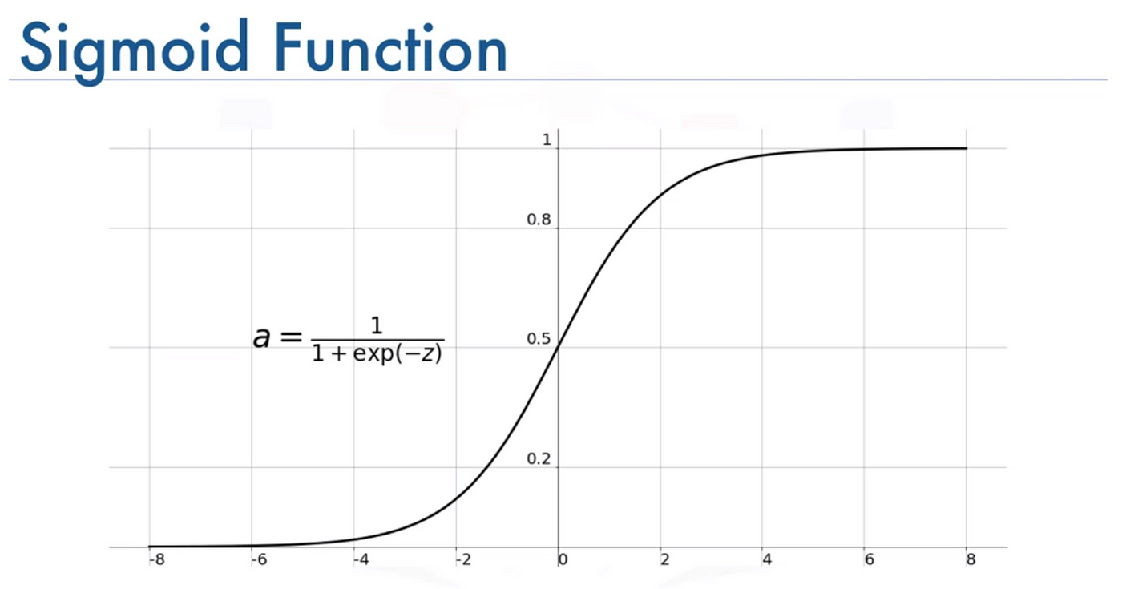
Model 2 - Sigmoid activation function
Model 2 uses sigmoid activation function in the output layer.
Normally, softmax is the most popular choice for the output layer activation function since the output is normally distributed, and thus is more suitable for multi class classification problems.

Slide 6
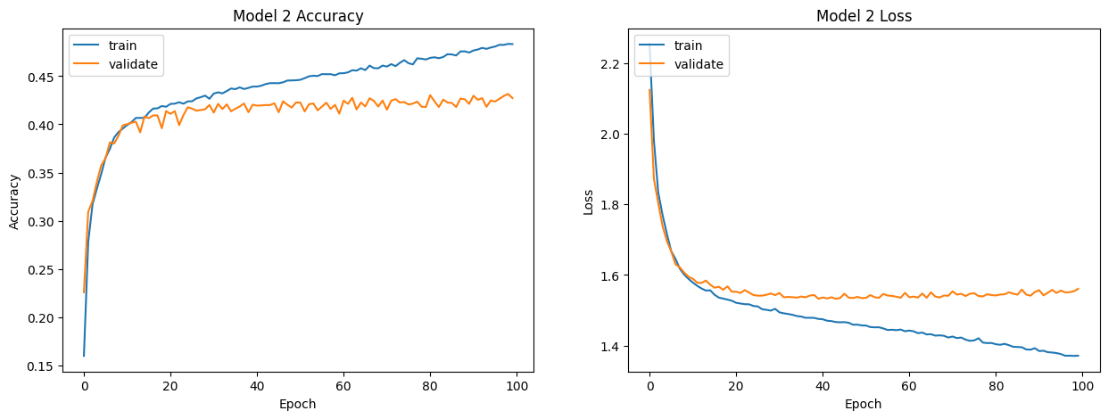
Model 2 - evaluation

Slide 7
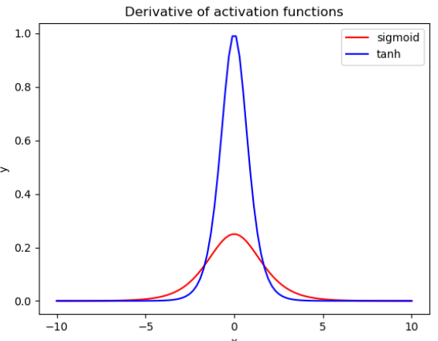
Model 3 – Tanh activation function
Stretched and shifted version of the sigmoid
The values it can take range from -1 to 1
The main difference relies on the gradient
Computationally more expensive
Since the gradient is bigger in tanh than in sigmoid around 0, the weight update will be bigger

Slide 8
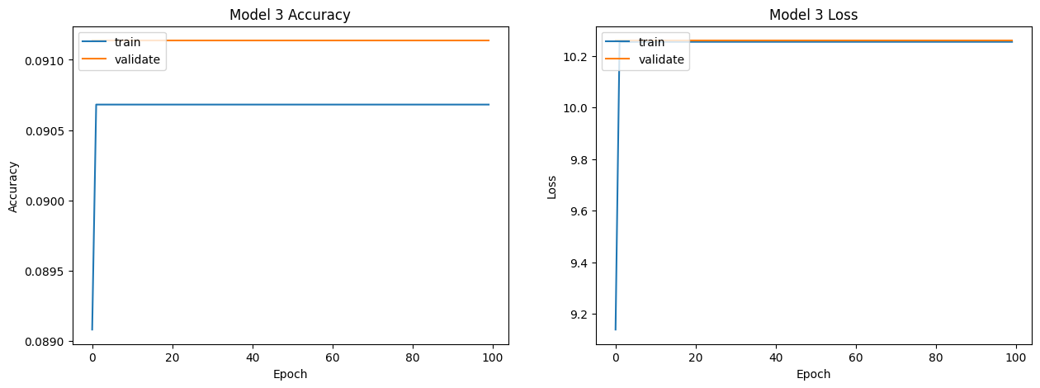
Model 3 - Evaluation

Slide 9
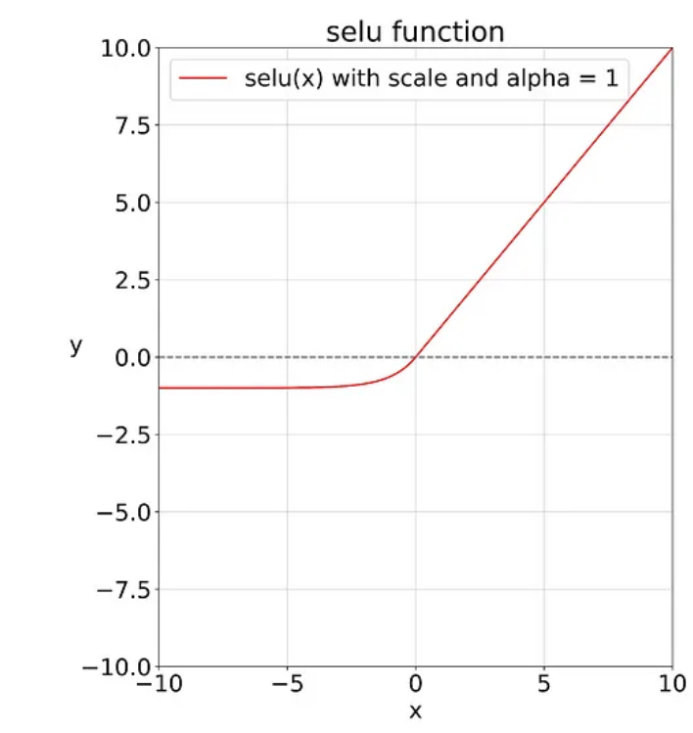
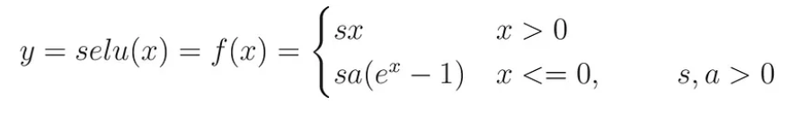
Model 4 – SELU activation function
SELU stands for scaled exponential linear unit
Keras default values:
Alpha = 1.67326324
Scale = 1.05070098

Slide 10
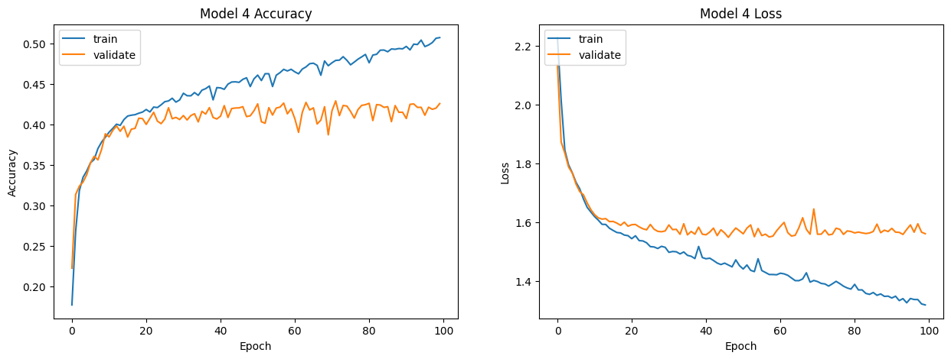
Model 4 - evaluation

Slide 11
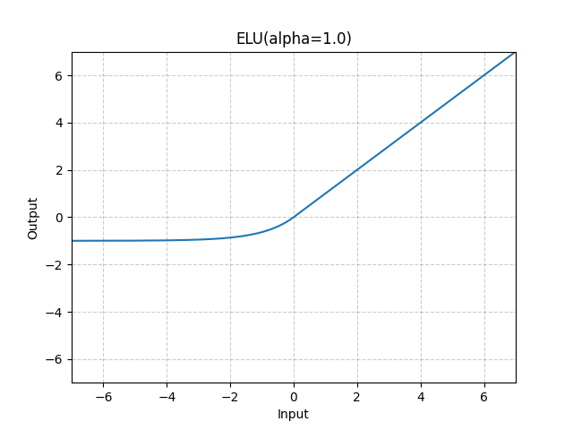

Model 5 – ELU activation function
ELU stands for exponential linear unit, and is similar to SELU but with no scale parameter
Keras defaults alpha to 1.0

Slide 12
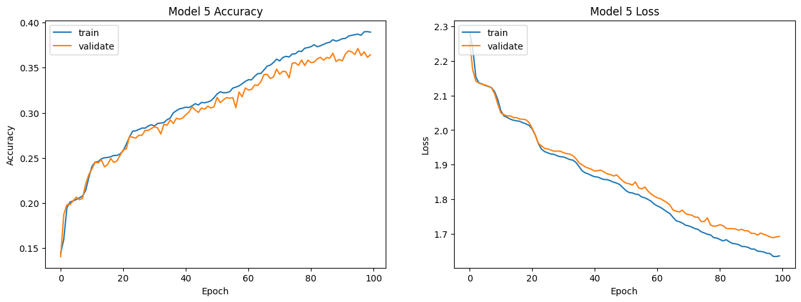
Model 5 - evaluation

Slide 13
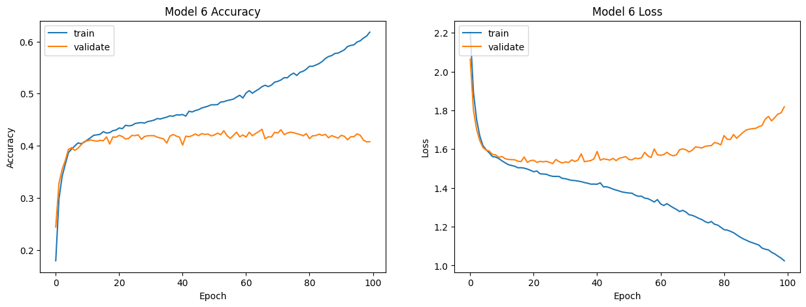
Model 6

Slide 14
Convolutional networks architecture
There were 3 convolutional models built plus the one specified in the paper
The architecture of the three models is as follows:
Convolutional layer – 256 filters – kernel size (1,3) - relu
Max Pooling layer – pool size (2,1)
Convolutional layer – 64 filters – kernel size (3,3) ) - relu
Max Pooling layer – pool size (2,2)
Input Dense layer – 128 neurons - relu
Dense layer – 256 neurons - relu
Output layer – 11 neurons - softmax
Models 9 through 11 vary in the learning rate → (0.001, 0.002, 0.003)
Used 0.5 dropout

Slide 15
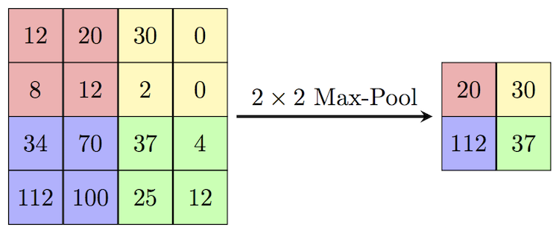
Max pooling
Max Pooling is an operation useful to extract features from images

Slide 16
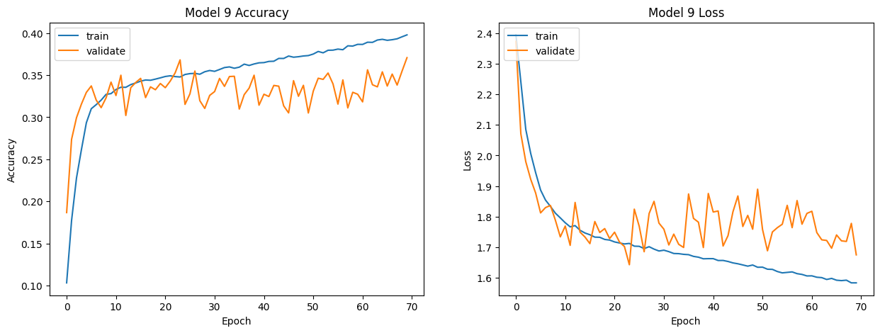
Model 9 – Adam optimizer lr = 0.001

Slide 17
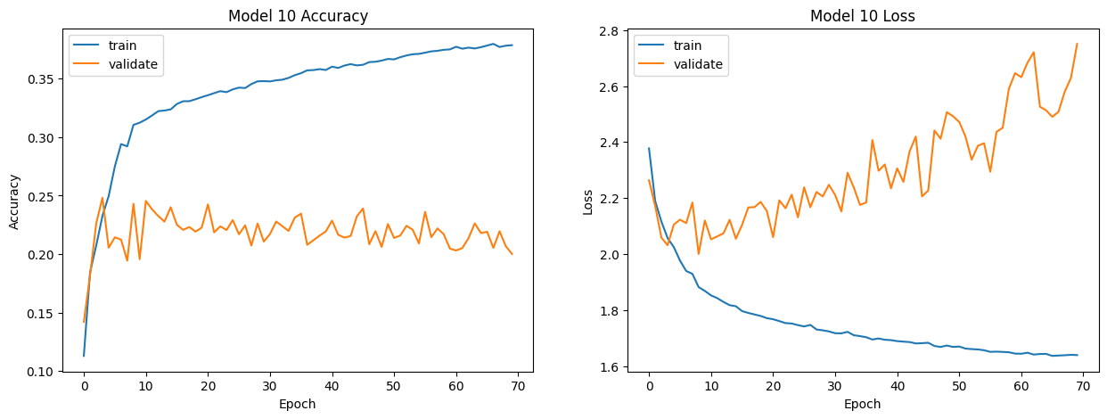
Model 10 – Adam optimizer lr = 0.002

Slide 18
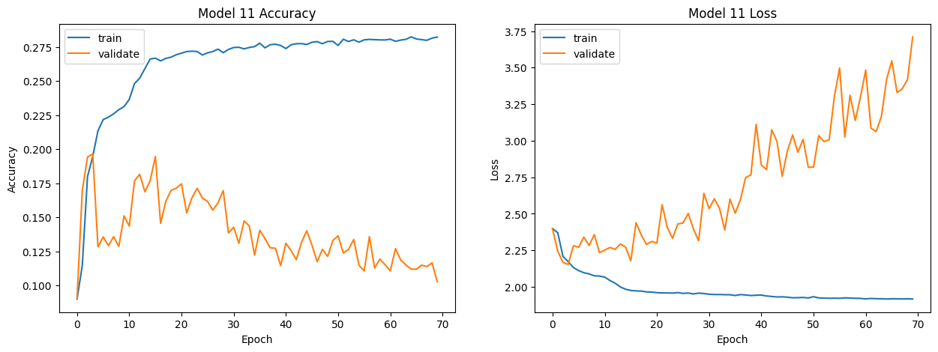
Model 11 – Adam optimizer lr = 0.003

Slide 19
Questions?

